Slide 1
Parallel and Distributed Computing
Distributed Computing

Slide 2
Contents
Definitions
History of Distributed Computing
Strengths and Weaknesses of Distributed Computing
Architecture of Distributed Applications

Slide 3
Definitions
A distributed system is one in which hardware or software components located at networked computers communicate and coordinate their actions only by message passing.
In the term distributed computing, the word distributed means spread out across space. Thus, distributed computing is an activity performed on a distributed system.
These networked computers may be in the same room, same campus, same country, or in different country.

Slide 4
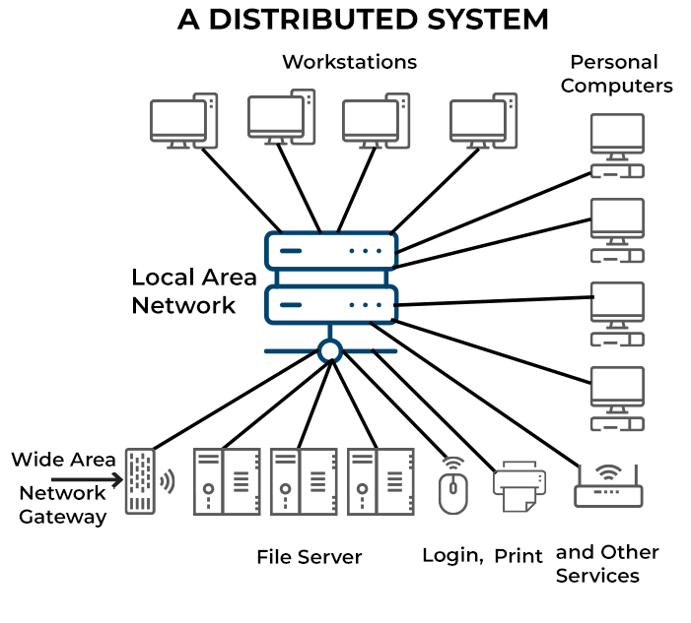
Definitions

Slide 5
Definitions
The numbers of real applications are still somewhat limited, and the challenges--particularly standardization--are still significant.
But there's a new energy in the market, as well as some actual paying customers, so it's about time to take a look at where distributed processing fits and how it works.
A distributed computing architecture consists of very lightweight software agents installed on a number of client systems, and one or more dedicated distributed computing management servers.
There may also be requesting clients with software that allows them to submit jobs along with lists of their required resources.

Slide 6
How it Works
Distributed systems don’t have a single design or implementation pattern—instead, they break down into patterns aligned with various types of business problems.
An example of this is the sharded pattern for stateful services like databases. This allows you to horizontally scale your data tier to avoid performance bottlenecks and single points of failure.
This pattern is illustrated in Figure 1 below and is commonly referred to as a distributed database.

Slide 7
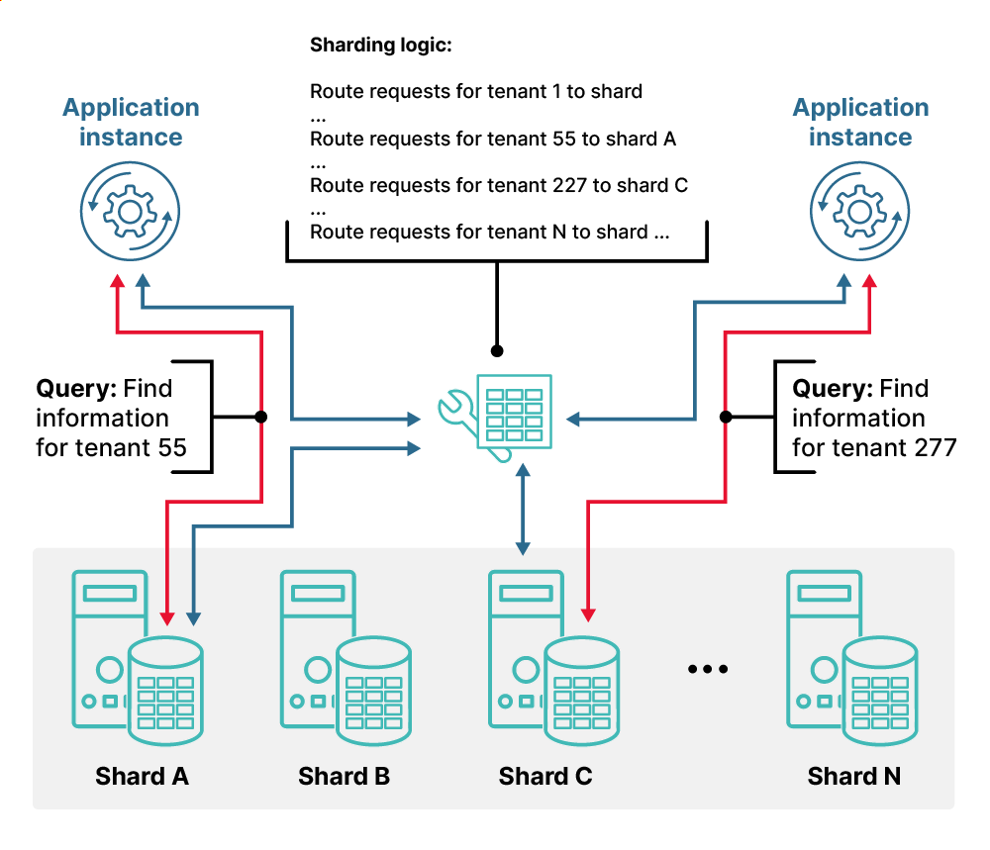
How it Works
Notes:
In distributed computing, a computation starts with a special problem-solving strategy. A single problem is divided up and each part is processed by one of the computing units. Distributed applications running on all the machines in the computer network handle the operational execution.
Distributed applications often use a client-server architecture. Clients and servers share the work and cover certain application functions with the software installed on them. A product search is carried out using the following steps: The client acts as an input instance and a user interface that receives the user request and processes it so that it can be sent on to a server. The remote server then carries out the main part of the search function and searches a database. The search results are prepared on the server-side to be sent back to the client and are communicated to the client over the network. In the end, the results are displayed on the user’s screen.
Middleware services are often integrated into distributed processes. Acting as a special software layer, middleware defines the (logical) interaction patterns between partners and ensures communication, and optimal integration in distributed systems. It provides interfaces and services that bridge gaps between different applications and enables and monitors their communication (e.g. through communication controllers). For operational implementation, middleware provides a proven method for cross-device inter-process communication called remote procedure call (RPC) which is frequently used in client-server architecture for product searches involving database queries.
This integration function, which is in line with the transparency principle, can also be viewed as a translation task. Technically heterogeneous application systems and platforms normally cannot communicate with one another. Middleware helps them to “speak one language” and work together productively. In addition to cross-device and cross-platform interaction, middleware also handles other tasks like data management. It controls distributed applications’ access to functions and processes of operating systems that are available locally on the connected computer.

Slide 8
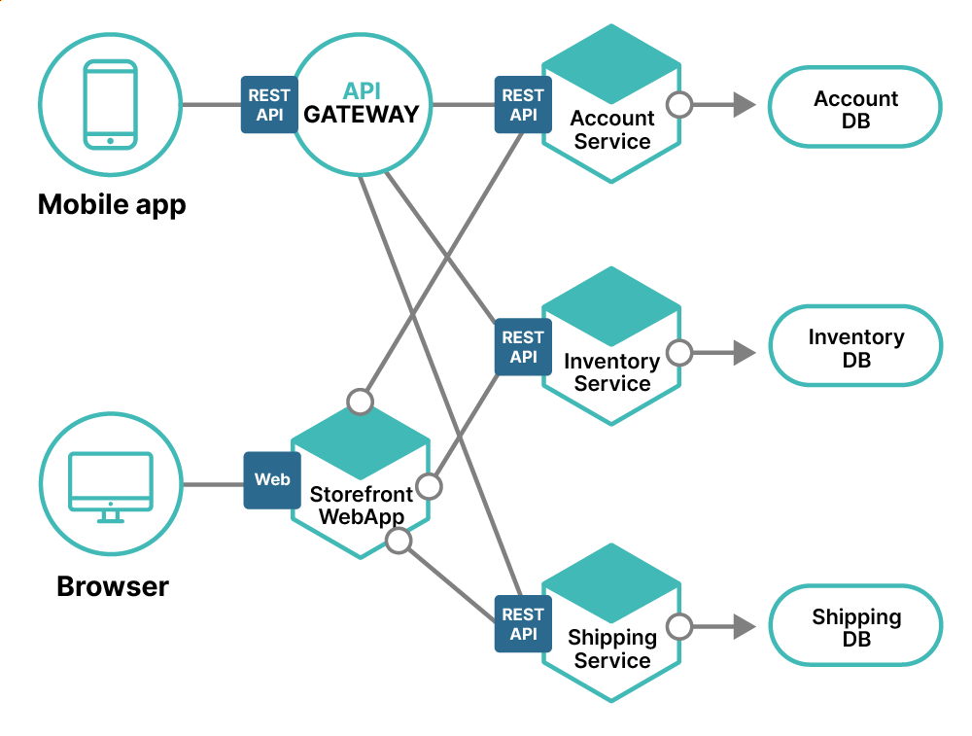
How it Works

Slide 9
History
The idea of using idle computer power for big projects is old. Early programs like Creeper explored this concept.
The first internet project like this was in 1988, where people helped factor large numbers by lending their computers' idle time.
In the 1990s, projects with cash rewards for solving puzzles like cracking encryption attracted more users.
SETI@Home, launched in 1999, used idle computers to search for alien signals and became the most famous project of this kind.
Notes:
History of Distributed Computing Projects
The idea of harnessing the unused CPU cycles of a computer is as old as the first networks that later became the Internet. The actual application of this idea has evolved with these networks, based on what terminals were available for use and what kinds of interactions could be facilitated. The kinds of distributed research projects in operation today were only created in the past few years with the growth of private Internet users and always-on high-speed access.
Worms
The first distributed computing programs were a pair of programs called Creeper and Reaper which made their way through the nodes of the ARPANET in the 1970s, the predecessor of the Internet. The Creeper came first and was a worm program, using the idle CPU cycles of processors in the ARPANET to copy itself onto the next system and then delete itself from the previous one. It was modified to remain on all previous computers and the Reaper was created which traveled through the same network and deleted all copies of the Creeper. In this way Creeper and Reaper were the first infectious computer programs and are actually often thought of as the first network viruses. They did no damage, however, to the computers they passed through and were instrumental in exploring the possibility of making use of idle computational power.
Another worm program which expanded on this process was the worm created by John F. Shoch and Jon A. Hupp of Xerox’s Palo Alto Research Center in 1973 to move through the computers in a local Ethernet network. It moved similarly to Creeper and Reaper through about 100 computers and used the idle CPU cycles for rendering computer graphics.
Research Challenges
The first Internet-based distributed computing project was started in 1988 by the DEC System Research Center. The project sent tasks to volunteers through email, who would run these programs during idle time and then send the results back to DEC and get a new task. The project worked to factor large numbers and by 1990 had about 100 users.
In the 1990s DEC and other groups began to use an Internet interface to distribute the material to be calculated, driven by challenges sponsored by RSA Security, Inc.’s research center, RSA Laboratories. These were puzzles like factoring and prime number searching, and encryption cracking, and came with cash rewards as incentives since the computation and time effort would presumably be large in order to solve any of the problems. RSA sponsored these challenges as research tools, so that they could solve large computational problems and do research in cryptology by having others groups compete to find the answers. Since computational power was key in these problems, groups pooled their efforts to cover more area.
The most prominent group, considered the first to actually use the internet to distribute data for calculation and collect the results, was a project founded in 1997 called distributed.net. They used independently owned computers as DEC had, but allowed the users to download the program that would utilize their idle CPU time instead of emailing it to them. Distributed.net completed several cryptology challenges by RSA Labs as well as other research facilities with the help of thousands of users.
SETI@Home
The project that truly popularized distributed computing and showed that it could work was SETI@Home, an effort by the Search for Extraterrestrial Intelligence (SETI) at the University of California at Berkeley. The project was started in May 1999 to analyze the radio signals that were being collected by the Arecibo Radio Telescope in Puerto Rico. It has gained over three million independent users who volunteer their idle computers to search for signals that may not have originated from Earth. This project has really brought the field to light, so that other groups and companies are quickly following their lead. (See Current Projects)

Slide 10
SETI@Home
The project that truly popularized distributed computing and showed that it could work was SETI@Home, an effort by the Search for Extraterrestrial Intelligence (SETI) at the University of California at Berkeley.
The project was started in May 1999 to analyze the radio signals that were being collected by the Arecibo Radio Telescope in Puerto Rico.
It has gained over three million independent users who volunteer their idle computers to search for signals that may not have originated from Earth.
This project has really brought the field to light, so that other groups and companies are quickly following their lead.

Slide 11
Examples of distributed computing in action
Here are some examples of where distributed computing is used. As you will discover, this concept is so common that we are all beneficiaries in one way or the other. Many of us encounter it without realizing it.
Social media
Online banking
Price comparison
Ride sharing
Streaming services
Search engines
File sharing
Email
Notes:
Social media
You're scrolling through your Facebook feed when a message pops up letting you know that your friend has just liked a post that you're also interested in. How does that work? Behind the scenes, Facebook is using distributed computing to quickly show you the post. This means that they've divided up the task of monitoring posts into small pieces and assigned them to different computers all over the world. When one computer finds something of interest, it sends a message to Facebook headquarters. There, they compile all of the messages from different computers to show you the post on your newsfeed.
Online banking
Online banking is a convenient way to manage your finances without having to visit a physical bank branch. But have you ever wondered how your device such as a computer or mobile phone is able to communicate with the bank's computers? The answer lies in distributed computing. In the case of online banking, your device is able to send and receive data from the bank's computers using this type of network. This allows you to check your account balance, transfer funds, and pay bills all from the comfort of your own home. So next time you log into your online banking account, remember that you're taking advantage of one of the many uses of distributed computing.
Price comparison
In online shopping, the distributed computing process is used to bring together the prices of products from different stores. It compares the prices of identical or similar products in order to find the best deal for the customer. This system can also be used to find discounts and coupons for customers. The distributed computing process speeds up this comparison by using multiple computers rather than just one computer. This allows customers to quickly compare prices and find deals.
Ride sharing
Companies like Uber and Lyft actually use a distributed system to match drivers with passengers. This system relies on thousands of individual computers (or nodes) to process requests. When you request a ride, your computer sends a signal to the nearest node, which then forwards it to the next closest node until it reaches the driver. This system is incredibly efficient and allows ride sharing companies to offer their services in hundreds of cities around the world.
Streaming services
Streaming services like Netflix, Amazon Prime Video, HBO GO, and Hulu use distributed computing to power their video-streaming platforms. In fact you might not know it but distributed computing is used extensively by streaming services to provide a scalable and reliable experience. By using multiple computers around the world, a streaming service can provide a much larger degree of scalability and reliability than would be possible with a single computer. For example, when Netflix first launched its streaming service, it used a distributed system to handle the enormous amount of data that was being streamed. This allowed them to provide a smooth and uninterrupted experience for their users. Today, Netflix continues to use distributed systems to power its massive worldwide operations.
Search engines
Think about the last time you searched for something online on a search engine. When you typed in a query and hit «enter,» your request was sent to a massive network of computers around the globe. These computers—known as servers—processed your request and sent back the results. Distributed computing is used heavily by search engines in order to process the large volume of data that they need to index and provide search results. By distributing the search tasks across multiple machines, search engines are able to quickly index and serve results for their users.
File sharing
When you download a file from the internet, your computer is doing the work of downloading the file. But, at the same time, you're also sharing that file with other people who are downloading it as well. So, in a way, you're all distributing the workload.
Email
When you send an email, your computer is sending it to the server. But, at the same time, your computer is also receiving emails from other people. So again, you're distributing the workload.

Slide 12
Advantages and benefits of Distributed Computing
Here are 7 key advantages and benefits of distributed computing;
Cost-effective
Increased storage
Enhanced security
Improved performance
Increased reliability
Greater flexibility and scalability
Low latency
Notes:
Cost-effective
There are many reasons why distributed computing is a cost-effective solution. For starters, it allows businesses to use the resources they already have, rather than investing in new infrastructure. Additionally, it can help reduce energy consumption and server load, making it more environmentally friendly.
Increased storage
Distributed computing allows for increased storage. This is because the data is not all stored in one central location but is instead spread out among different computers.
This means that if one computer fails, the data is still accessible from the other computers. It also means that if you need more storage space, you can simply add more computers to the network.
Enhanced security
When data is distributed across multiple machines, it becomes much harder for hackers to gain access and steal information. This is because the data is not centralized in any one place, making it more difficult to hack into.
Additionally, by using multiple machines, you can create a more diverse and secure network. If one machine is compromised, the others will still be safe. This ensures that your data is always protected.
Improved performance
When tasks are distributed across multiple machines, the overall execution time is reduced. This is because each machine can work on a portion of the task at a time, and when the tasks are combined, the overall execution time is reduced.
This improved performance can be especially beneficial in situations where large amounts of data need to be processed. For example, if you're trying to analyze a large set of data, distributing the workload across multiple machines can result in a significant reduction in processing time.
Increased reliability
One of the biggest advantages of distributed computing is its increased reliability. By using multiple computers to complete a task, the chances of an error occurring are quite minimal. This is because if one computer fails, the task can be completed by the remaining computers.
Greater flexibility and scalability
With a distributed system, you can easily add or remove nodes (computers) from the network, making it easy to adapt to changing needs. You can also scale the system up or down as needed, either temporarily or permanently, ensuring that you always have the resources you need. This also makes it possible to handle larger workloads and accommodate more users without any slowdown or interruption.
This is unlike a centralized system where all of the data and processing power is located in one place, making it cumbersome to scale.
Low latency
Latency is defined as the duration it takes for a packet of data to travel from one point to another. When it comes to distributed computing, low latency is a key benefit as this system can move large amounts of data within a short timeframe. The faster data can be worked on and sent back out, the faster the entire system will run.
Thanks to advances in technology, most distributed systems now have a latency of less than 100 milliseconds. This ensures that your applications will run smoothly and without any glitches. In fact, according to Stanford University, low latency is one of the key goals of distributed computing.

Slide 13
Drawbacks of Distributed Computing
While distributed computing delivers many benefits as we have seen, it also has its fair share of drawbacks and disadvantages.
Here is a look at some of the drawbacks of distributed computing
Network transfer bottlenecks
System complexity
Standardization issues
Maintenance costs
Potential for component failure due to human error
Bandwidth limitations
Deploy challenges
Notes:
While distributed computing delivers many benefits as we have seen, it also has its fair share of drawbacks and disadvantages. Here is a look at some of the drawbacks of distributed computing;
1. Network transfer bottlenecks
When data is distributed across multiple nodes, it needs to be transferred between them. This can create a bottleneck if the network connection between the nodes is slow or congested.
For example, consider a company that uses a distributed computing system to process sales transactions. If the network connection between the nodes is slow, it can delay or even prevent transactions from being processed.
2. System complexity
Distributed computing can lead to increased system complexity. With multiple systems working together, it can be difficult to track and manage all of the moving parts. This can lead to system failures and data inconsistencies.
3. Standardization issues
Because there are so many different types of distributed systems, it can be difficult to find one that fits your specific needs. Additionally, each system has its own set of commands and procedures, which can make it difficult to learn and use.
4. Maintenance costs
Distributed computing can be expensive to maintain. Since the systems are spread out across multiple locations, it can be more difficult to troubleshoot and fix problems when they arise. In addition, the increased number of components also means that there is a greater potential for hardware and software failures. As a result, companies often need to allocate more resources to maintaining their distributed computing systems.
5. Potential for component failure due to human error
There's always the potential for human error when dealing with multiple components and systems. This occurs when someone who is not familiar with the system makes a mistake that leads to component failure. For example, if a programmer accidentally deletes a critical file, it could render the entire system inoperable. Another example might be if an administrator incorrectly configured the network settings, preventing users from being able to access the system. While human error can lead to component failure, there are steps that can be taken to minimize the risk. For example, developers can create comprehensive documentation and training materials to help reduce the likelihood of users making mistakes. Additionally, you can design systems with built-in checks and balances to help prevent accidental deletions or other types of mistakes.
6. Bandwidth limitations
In order for all nodes in the system to communicate with each other, they need to share a common bandwidth limit. When this limit is reached, the system becomes bottlenecked and performance will start to degrade.
This is often a problem for large-scale distributed systems, as the amount of data that needs to be transferred can quickly exceed the available bandwidth. As a result, careful planning and design is needed to ensure that all nodes in the system can still communicate effectively with each other.
7. Deploy challenges
In order for a distributed system to work effectively, all of the nodes (computers) in the network have to be configured in the same way and be able to communicate with each other. This can be a challenge for organizations with more complex IT infrastructure but inadequate skill sets among their IT staff.

Slide 14
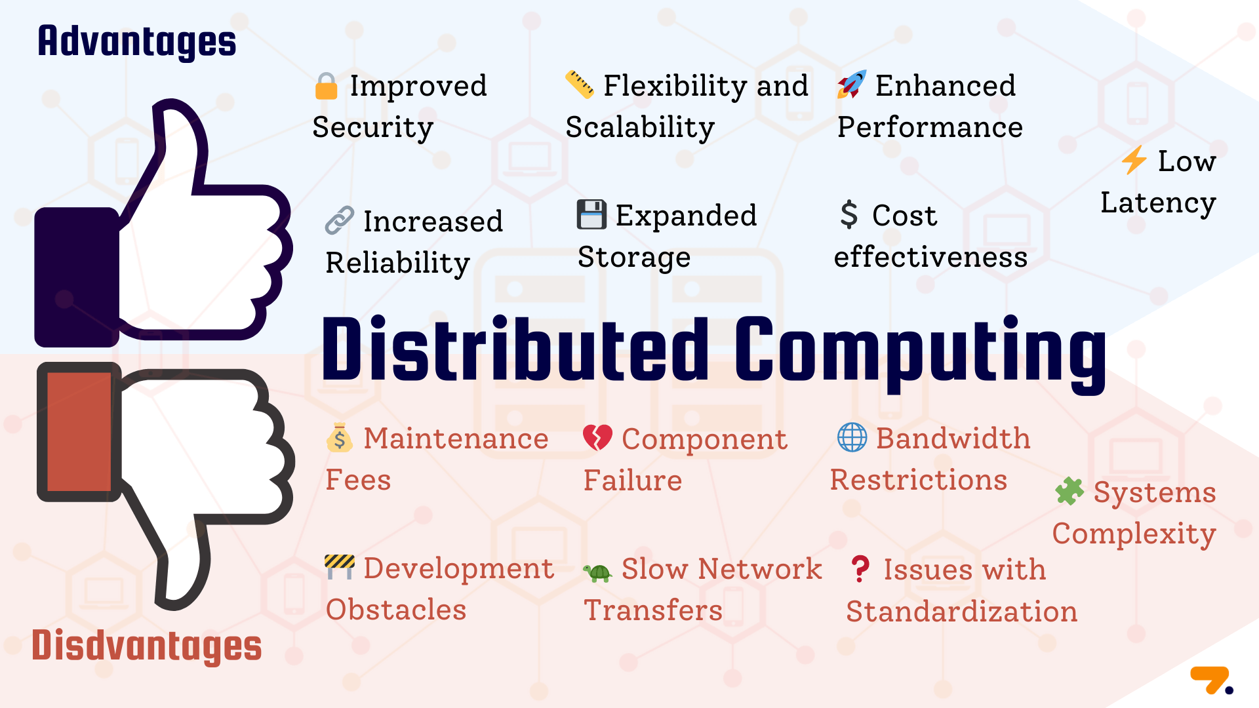
Advantages and benefits of Distributed Computing
Notes:
Cost-effective
There are many reasons why distributed computing is a cost-effective solution. For starters, it allows businesses to use the resources they already have, rather than investing in new infrastructure. Additionally, it can help reduce energy consumption and server load, making it more environmentally friendly.
Increased storage
Distributed computing allows for increased storage. This is because the data is not all stored in one central location but is instead spread out among different computers.
This means that if one computer fails, the data is still accessible from the other computers. It also means that if you need more storage space, you can simply add more computers to the network.
Enhanced security
When data is distributed across multiple machines, it becomes much harder for hackers to gain access and steal information. This is because the data is not centralized in any one place, making it more difficult to hack into.
Additionally, by using multiple machines, you can create a more diverse and secure network. If one machine is compromised, the others will still be safe. This ensures that your data is always protected.
Improved performance
When tasks are distributed across multiple machines, the overall execution time is reduced. This is because each machine can work on a portion of the task at a time, and when the tasks are combined, the overall execution time is reduced.
This improved performance can be especially beneficial in situations where large amounts of data need to be processed. For example, if you're trying to analyze a large set of data, distributing the workload across multiple machines can result in a significant reduction in processing time.
Increased reliability
One of the biggest advantages of distributed computing is its increased reliability. By using multiple computers to complete a task, the chances of an error occurring are quite minimal. This is because if one computer fails, the task can be completed by the remaining computers.
Greater flexibility and scalability
With a distributed system, you can easily add or remove nodes (computers) from the network, making it easy to adapt to changing needs. You can also scale the system up or down as needed, either temporarily or permanently, ensuring that you always have the resources you need. This also makes it possible to handle larger workloads and accommodate more users without any slowdown or interruption.
This is unlike a centralized system where all of the data and processing power is located in one place, making it cumbersome to scale.
Low latency
Latency is defined as the duration it takes for a packet of data to travel from one point to another. When it comes to distributed computing, low latency is a key benefit as this system can move large amounts of data within a short timeframe. The faster data can be worked on and sent back out, the faster the entire system will run.
Thanks to advances in technology, most distributed systems now have a latency of less than 100 milliseconds. This ensures that your applications will run smoothly and without any glitches. In fact, according to Stanford University, low latency is one of the key goals of distributed computing.

Slide 15
Different Types of Distributed Computing
Applications that run on numerous computers as opposed to only one are made for distributed computing.
By developing the program, you may make it so that many computers work together to complete various tasks and provide the desired outcome.
The following list includes the four main types of distributed architecture;
Client-server architecture
Three-tier architecture
N-tier architecture
Peer-to-peer architecture
Notes:
Client-server architecture: Client-server architecture is the most common type of distributed system software organization. The two categories into which the jobs are separated are clients and servers. The ability of clients to process information is limited. Instead, the servers, which control the majority of the data and other resources, get queries. You submit questions to the client, which response to the server on your behalf. Resource access is coordinated and managed by server systems. In response to client queries, they give statistics or status updates. One server often has the capacity to react to requests originating from several computers.
Client-server architecture has the benefits of security and ease of continuous management. You should solely focus on safeguarding the server equipment. Similarly to this, database system improvements only need server-side changes. The disadvantage of client-server architecture is the possibility of server-caused communication bottlenecks, especially when numerous workstations are submitting requests simultaneously.
Three-tier architecture: With three-tier distributed systems, client machines continue to be the first layer you encounter. There are two more categories for server machines on the other side. The middle tier of communication is performed by application servers. They consist of the core operations or program logic for which the distributed system was designed. Database servers make up the third layer for handling and storing data. They are in charge of retrieving data and maintaining data integrity. By spreading server responsibilities, three-tier distributed systems reduce communication bottlenecks and improve the effectiveness of distributed computing.
N-tier architecture: N-tier models employ several client-server systems working together to solve a single problem. Many contemporary distributed systems have an n-tier architecture, with a number of business apps cooperating as one system in the background.
Peer-to-peer architecture: Peer-to-peer distributed systems assign the same tasks to each networked machine. Computers are not divided between client and server types, and each one is capable of doing any work. Peer-to-peer architecture has become more popular for use in content exchange, blockchain networks, and media streaming.

Slide 16



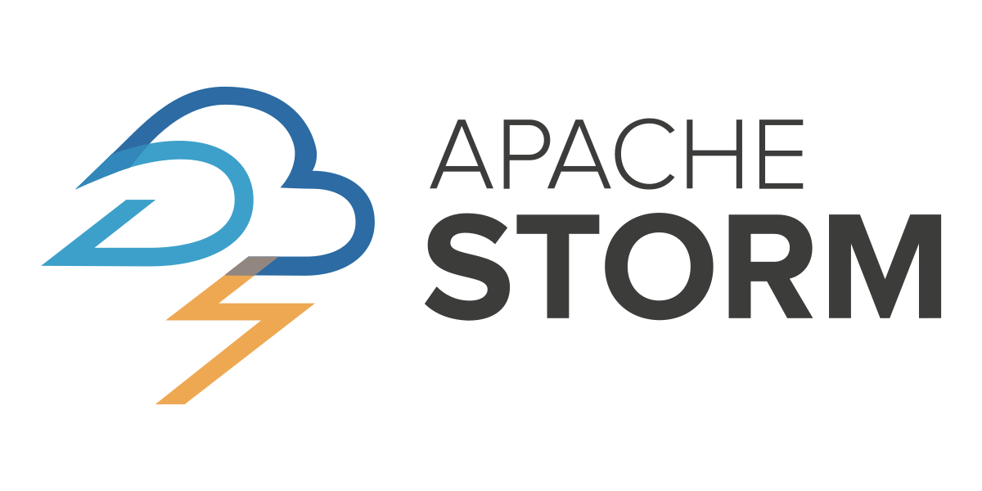
Most Popular Distributed Computing Frameworks And Tools
These are only a handful of the numerous distributed computing frameworks that are accessible.
It's critical to select the option that most closely matches the unique requirements of your company because each has strengths and drawbacks of its own.
The most common distributed computing tools are outlined below:
Hadoop
Spark
Flink
Storm
Notes:
Hadoop: The most well-known distributed computing framework is undoubtedly Hadoop. It is an open-source project built on the MapReduce programming methodology and was created by the Apache Software Foundation. Large volumes of data are frequently processed in batches using Hadoop.
Spark: Based on the Resilient Distributed Datasets (RDD) programming model, Spark is an additional open-source distributed computing platform. It is frequently used for both batch and stream processing since it is intended to be quicker and more adaptable than Hadoop.
Flink: Flink is an that was created primarily for stream processing. Because of its capacity to handle both batch and stream data as well as real-time data processing, it is becoming more and more popular.
Storm: Storm is a . It fits well for real-time processing use cases including analytics, online machine learning, real-time dashboards, and more since it is easy to use, can be used with any programming language, and is straightforward.

Slide 17
Key Components Of Distributed Architectures
Distributed systems are complex and can vary greatly depending on their specific use case and architecture. However, the following core components are present in most distributed systems:
Nodes
These are the individual computers or servers that make up the distributed system. Each node runs its own instances of the applications and services that make up the system.
Network
This is the communication infrastructure that connects all nodes. The network enables data and information to be exchanged between nodes.

Slide 18
Key Components Of Distributed Architectures
Middleware
This software layer provides a programming model for developers and masks the heterogeneity of the underlying network, hardware, and operating systems. It provides useful abstractions and services which simplify the process of creating complex distributed systems.
Shared Data/Database
This is where the system stores and retrieves data. Depending on the specific design of the distributed system, the data could be distributed across multiple nodes, replicated, or partitioned.
Distributed Algorithms
These are the rules and procedures nodes follow to communicate and coordinate with each other. They enable nodes to work together, even when some nodes fail or network connections are unreliable.

Slide 19
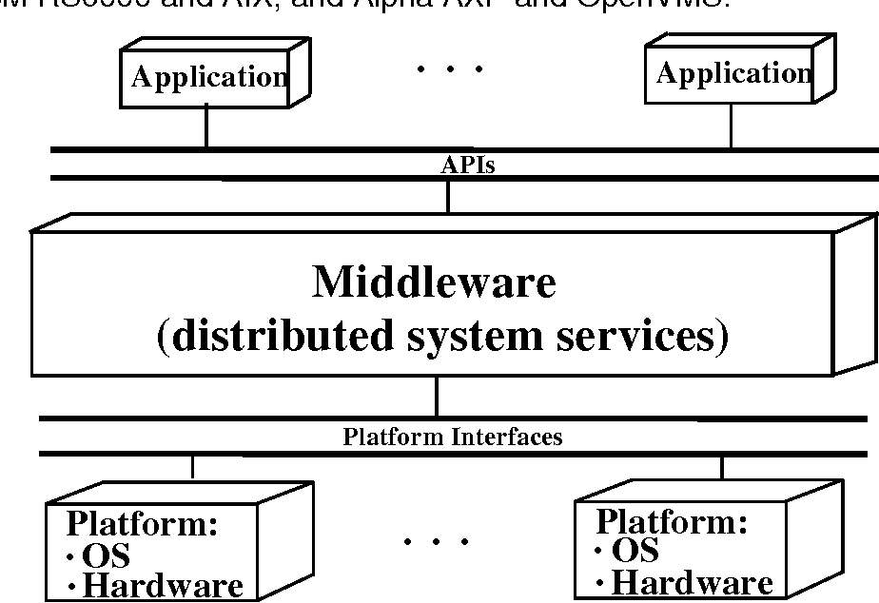
Key Components Of Distributed Architectures
System Management Tools
These tools help manage, monitor, and troubleshoot the distributed system. They provide functionality for load balancing, fault tolerance, system configuration, and more.

Slide 20
Distributed Computing vs. Related Concepts

Slide 21
Distributed Computing vs. Cloud Computing
Distributed computing involves a collection of independent computers connected via a network, working together to perform tasks. Each computer in a distributed system operates autonomously, and the system is designed to handle failures of individual machines without affecting the entire system's functionality.
Cloud computing is a model for delivering computing services over the internet. It provides on-demand access to shared computing resources, such as servers, storage, and applications, without direct active management by the user. While distributed computing is about the system architecture, cloud computing is more about service delivery.

Slide 22
Distributed Computing vs. Grid Computing
Grid computing involves using the unused processing power of computers connected over a network (often the internet), to solve complex computational problems. It is a decentralized form of distributed computing where each node is independent, and there is no central coordinating system.
In contrast, distributed computing can be either centralized or decentralized, depending on the architecture. It involves multiple computers sharing the workload to achieve common goals. The computers in a distributed system may be physically close together and connected by a local network, or they may be geographically distant and connected by a wide area network.

Slide 23
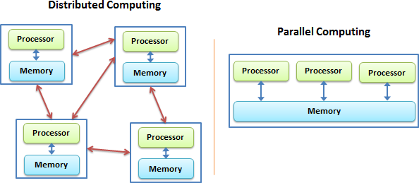
Distributed Computing vs. Parallel Computing
Parallel computing is a type of computation in which many calculations or processes are carried out simultaneously. It breaks down a large problem into smaller, independent parts that can be solved concurrently.
While distributed computing and parallel computing share the objective of processing tasks more quickly, they differ in how they achieve this. In parallel computing, all processors may have access to shared memory to exchange information, while in distributed systems, each node has its own memory.

Slide 24
Examples of Distributed Systems
Examples of distributed systems and applications of distributed computing include the following:
Telecommunication networks:
Telephone networks and cellular networks
Computer networks such as the Internet
Network applications:
World wide web and peer-to-peer networks
Massively multiplayer online games and virtual reality communities
Real-time process control:
Aircraft control systems
Industrial control systems
Parallel computation:
Scientific computing, including cluster computing and grid computing and various volunteer computing projects
Distributed rendering in computer graphics

